Slide 1

Special Topics in Analytics
By: Priyanka Bhosale
July 25, 2024

Slide 2
Features description and Engineered Features
Summary Data Features: user_id, device, duration_min, avg_power_mi, date_time
Engineered Features to measure Longetivity metrics:
total_workout_duration: Total workout duration for each user
workout_consistency_sd: To measure the variability in the number of days between workouts for each user
Calculate the difference in “days_between” each consecutive workout.
Calculate the Standard Deviation of the ”days_between” for each user
sustained_engagement: The time span from the first to the last workout for each user
duration_min_sd: To measure the variability in the duration of workouts
Workout duration consistency can be seen as Fatigue
A low standard deviation means the durations are consistent and implies less fatigue
weekly_avg_power: Average power per week for each user
high_consistency 0 or 1
Approach-1:
Set it to 0 (No) if the standard deviation of the workout consistency for the patient > threshold (median standard deviation of workout consistency)
Set is as 1 (Yes) if the standard deviation of the workout consistency for the patient < threshold (median standard deviation of workout consistency)
Approach-2:
Set it to 0 (No) if the standard deviation of the workout duration for the user > threshold (median standard deviation of workout duration)
Set is as 1 (Yes) if the standard deviation of the workout duration for the user < threshold (median standard deviation of workout duration)

Slide 3
Method Used
Method Used:
Clustering (KMeans) on the basis of longevity features (engineered)
Test set: 20%
Total Clusters:
Device-1 dataset: 6 (0 to 5)
Device-2 dataset: 7 (0 to 6)
Hypothesis Testing using t-test
Random Forest Classifier: Feature importance for device-1 and device-2
Train set: 80%

Slide 4
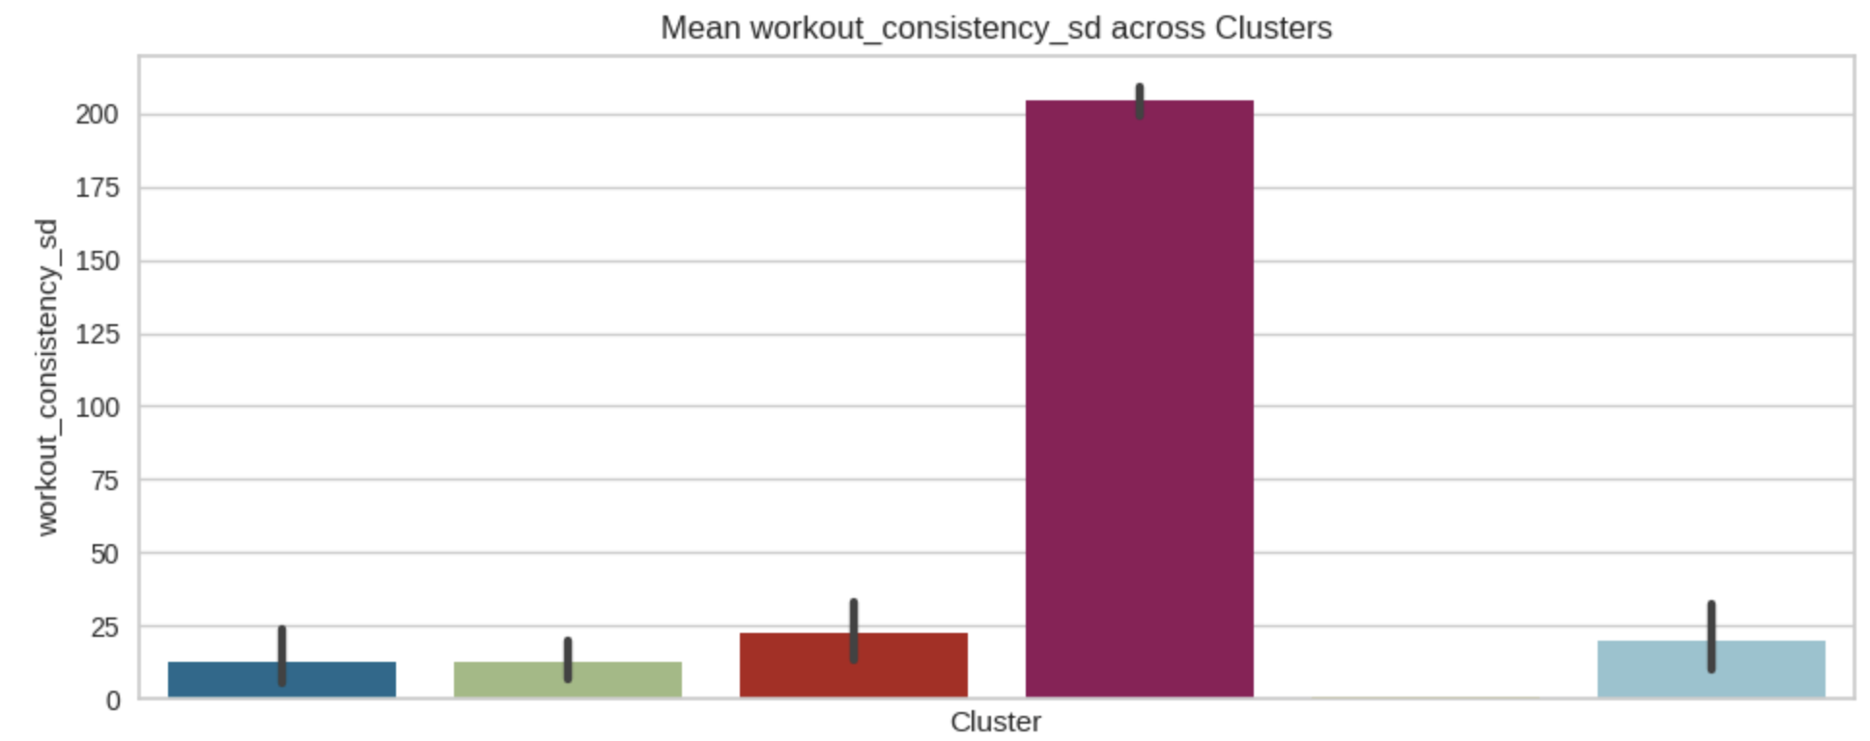
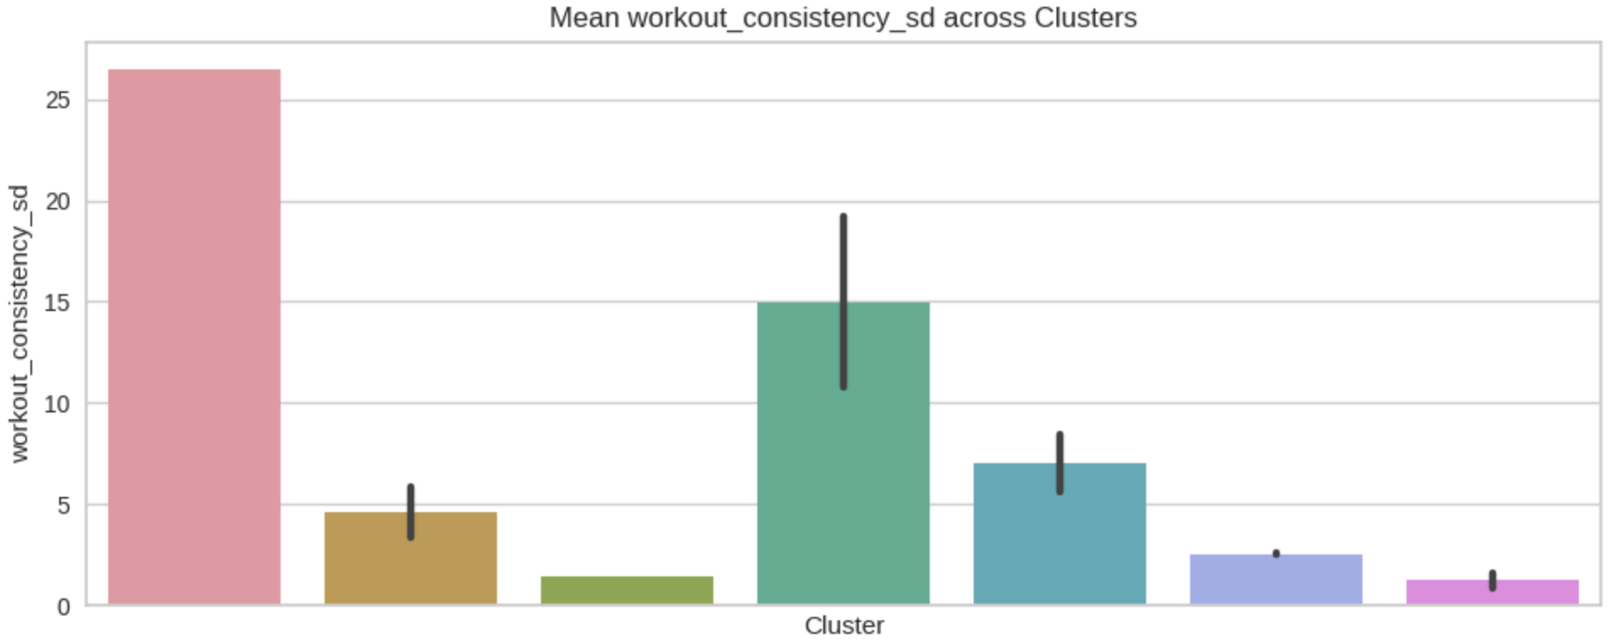
Question-1: What are the optimal patient subtypes (clusters) for longevity (consistency)
Device-1 users consistency cluster order (best to worst): 4, 1, 0, 5, 2, 3
User_id:
Cluster-0: 1702329495, 1702333022, 1702333567, 1702336610, 1702490242, 1702490592, 1702490893, 1702922137, 1702922500, 1702923181, 1702935311, 1703008928, 1703009496, 1703089326
Cluster-1: 1702933150, 1702934123, 1702935842, 1703008693, 1703008907, 1703009028, 1703089640, 1703089748, 1703092110, 1703092207, 1703092794, 1703092810, 1703092908, 1703093190, 1703093228
Cluster-2: 1702490345, 1702922923, 1702924714, 1702931295, 1702931398, 1702934205, 1702935394, 1702935657, 1702935769, 1703008735, 1703009051, 1703009164, 1703009294, 1703009403, 1703009575, 1703089540, 1703089571, 1703089606, 1703092168, 1703092871
Cluster-3: 1703092894, 1703093176
Cluster-4: 1703107708
Cluster-5: 1702336416, 1702490329, 1702924246, 1702924413, 1702924516, 1702924633, 1702933226, 1702934516, 1702935733, 1703009094, 1703089411, 1703089659, 1703091959, 1703092008, 1703092049, 1703092087, 1703092147, 1703092185, 1703092780
Device-2 users consistency cluster order (best to worst): 6, 2, 5, 1, 4, 3, 0
User_id:
Cluster-0: 1702934484
Cluster-1: 1702328605, 1702336541, 1702490971, 1702491522, 1703008601, 1703008618, 1703008716, 1703008811, 1703009359, 1703009439, 1703092827
Cluster-2: 1702330543
Cluster-3: 1703009229, 1703009462
Cluster-4: 1703008860, 1703009255, 1703089705
Cluster-5: 1702491462, 1702924337
Cluster-6: 1702328673, 1703008658

Slide 5
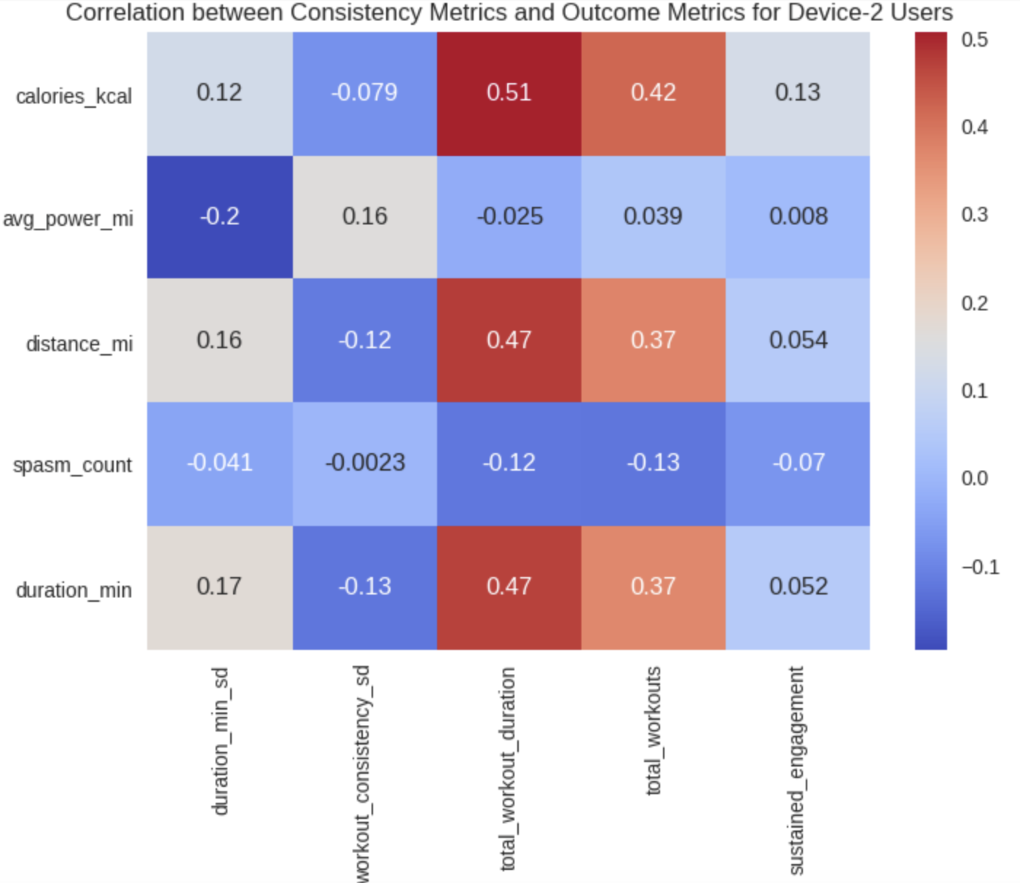
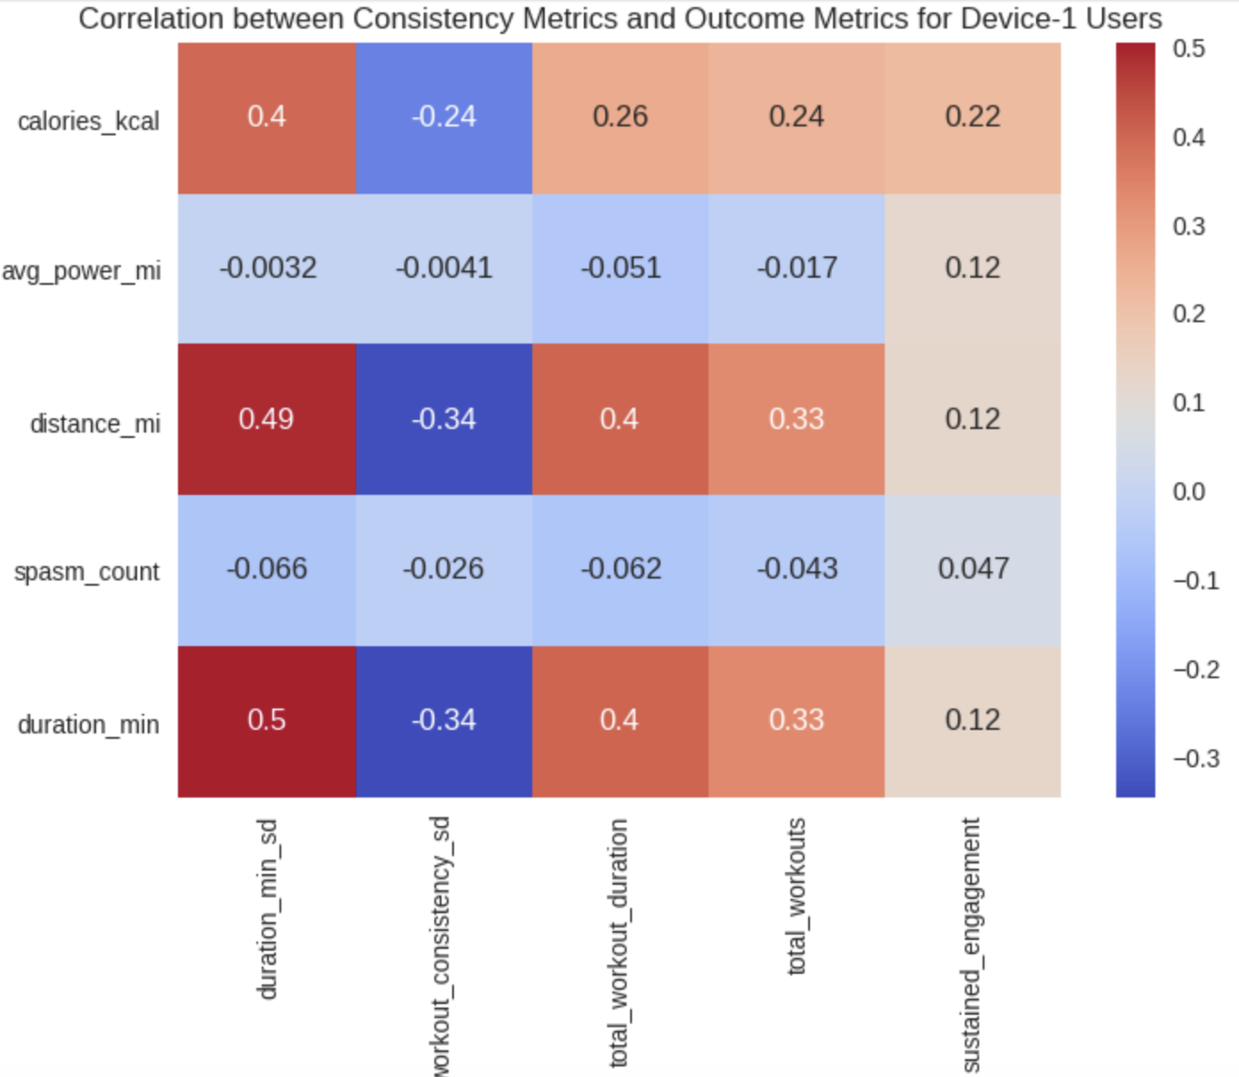
Question 2: Do spasm count have an impact on longevity (consistency)?
High Correlations:
Calories: Workout Duration SD, Total Workout Duration, Total Workouts, Sustained Engagement
Distance: Workout Duration SD, Total Workout Duration, Total Workouts, Sustained Engagement
Duration: Workout Duration SD, Total Workout Duration, Total Workouts, Sustained Engagement
Conclusion: None of the longevity metrics have a high correlation with Spasm Count

Slide 6
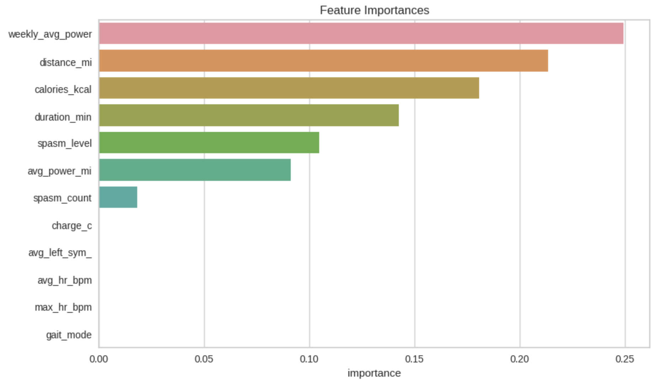
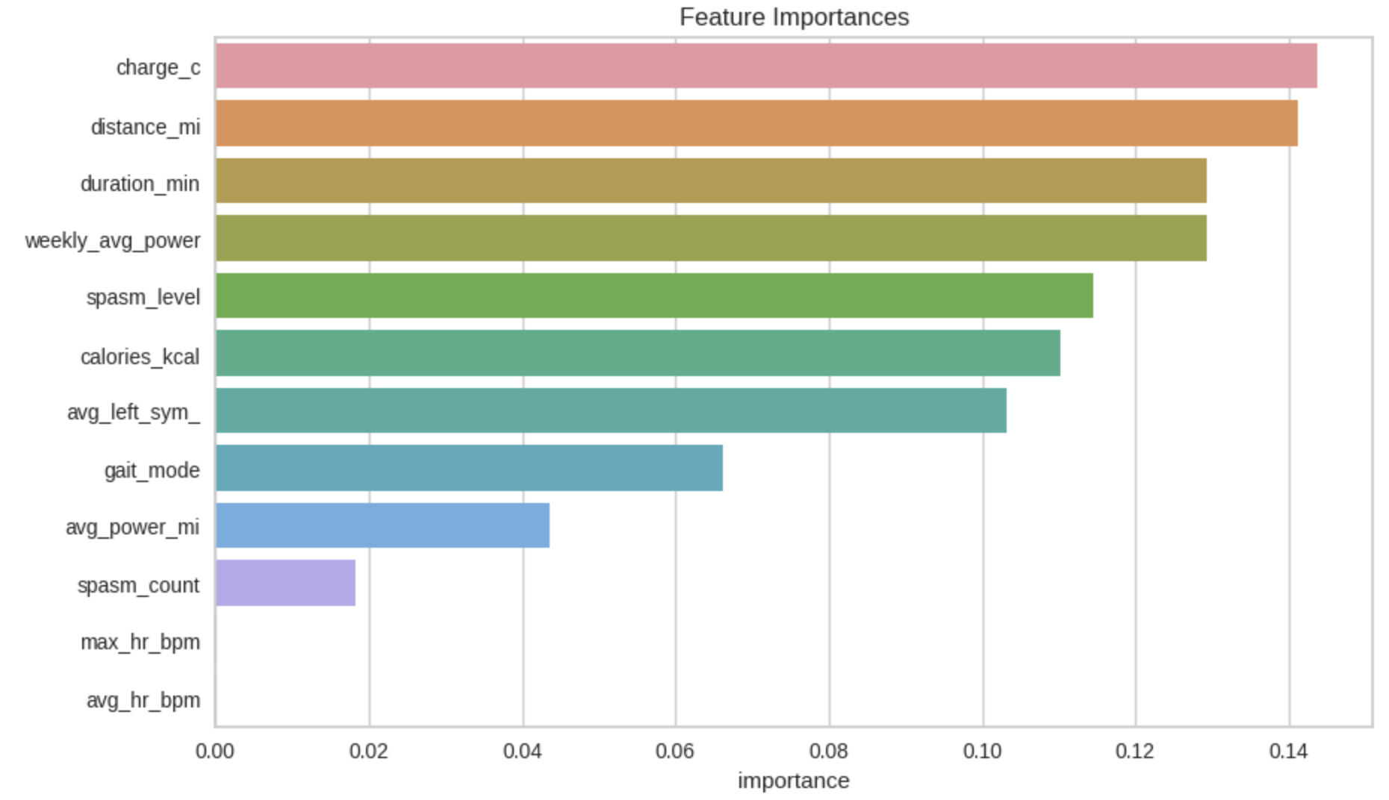
Approach-1: Significant features for target ‘High Consistency’
Approach-1: Median consistency (SD) considered as the threshold
Definitions:
High Consistency Users: If User’s consistency (SD) > Threshold
Low Consistency Users: If User’s consistency (SD) < Threshold
Top 4 important features identified:
Device-1: Weekly Average Power + Distance + Calories + Workout Duration
Device-2: Charge + Distance + Duration + Weekly Average Power

Slide 7
Approach-2: Significant features for target ‘High Consistency’
Approach-2: Median workout duration (SD) considered as the threshold
Definitions:
High Consistency Users: If user’s workout duration (SD) > Threshold
Low Consistency Users: If user’s workout duration (SD) < Threshold
Conclusion: Top 4 important features identified in approach-1 and approach-2 match 100%

Slide 8
What are the motivating factors for patients?
Motivating factors for Device-1 patients:
Weekly Average Power, Distance, Calories, Workout Duration
Motivating factors for Device-2 patients:
Charge, Distance, Duration, Weekly Average Power
Converts to Efficiency
Conclusion: It is likely that the users return to do workouts if they maintain a consistent Weekly Average Power

